Slide 1


Composting Combinatorics
Michael O. Chen | Hillcrest High School
March 2, 2023

Slide 2
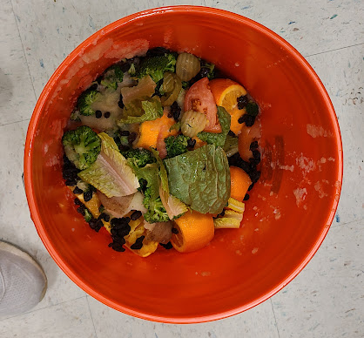

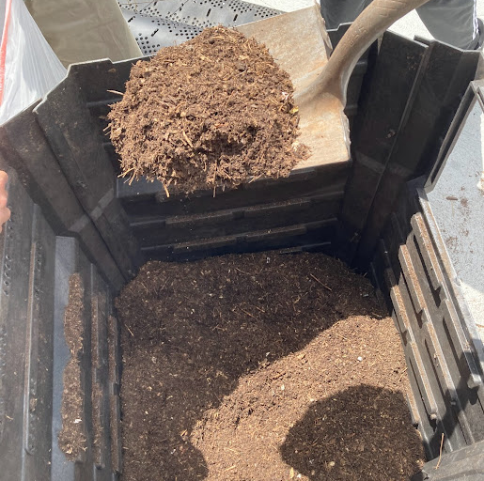

Slide 3
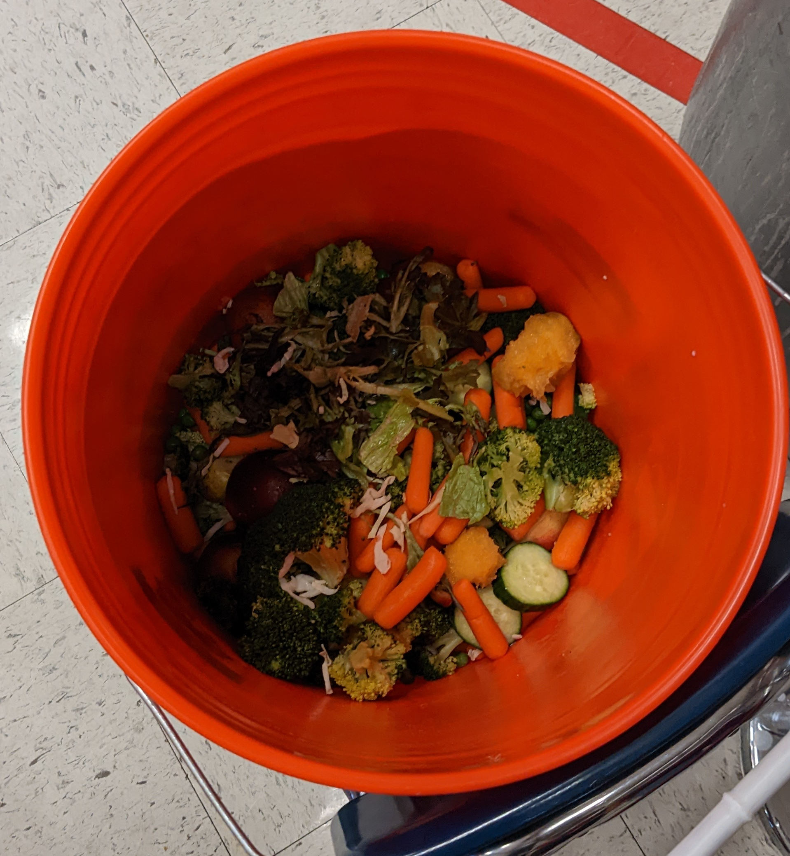
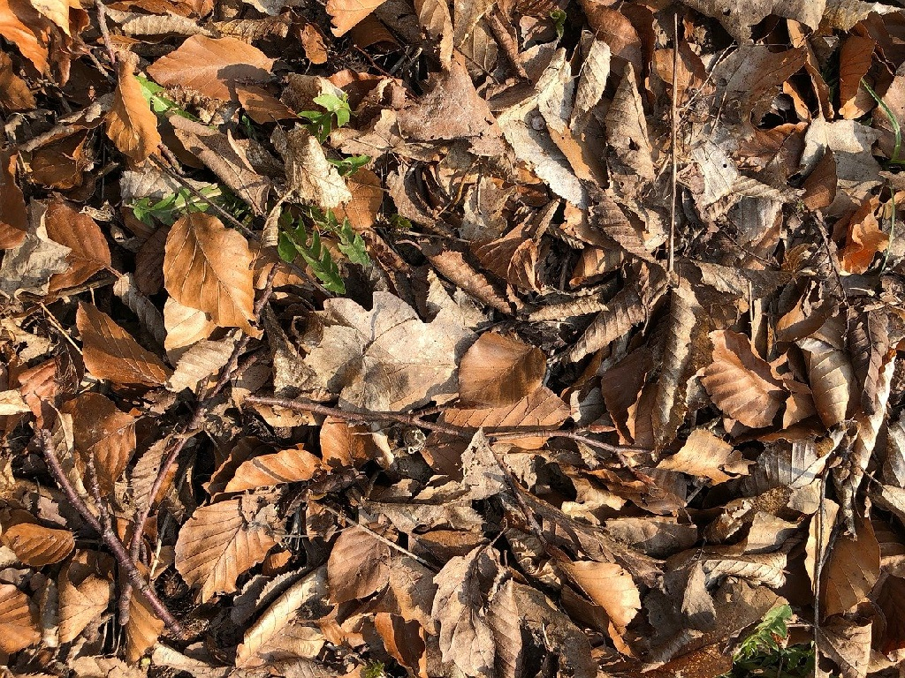
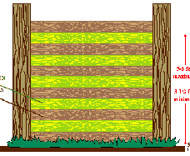
Basics of composting
GREEN
Composts require a balance of carbon-rich and nitrogen-rich materials.
Carbon-rich = “brown” materials (leaves, paper, trimmings)
Nitrogen-rich = “green” materials (fruit and vegetable scraps)
Layering --> build a compost pile by adding alternating layers of green and brown materials.
The ideal carbon to nitrogen ratio (C:N ratio) is 30:1.
BROWN

Slide 4
The problem
Each day, a school produces an amount of fruit and vegetable waste which constitutes a green layer.
Thus, the problem: given some green layer and a particular collection of available brown materials, what combination of browns should be added to achieve the ideal C:N ratio and maximize other criteria?
Each combination consists of weights for each brown material to be added.

Slide 5
Brute force
Simple brute force solution: iterate through all possible combinations, save all combinations with a CN ratio of 30:1.

Slide 6
Brute force
Each box represents one available brown material
Weight 1 | Weight 2 | … | Weight X
Let this array represent a combination.

Slide 7
Brute force
0 | 0 | … | 0
Let this array represent a combination. Each box represents one available brown material, and contains the weight of that material.
Min weight 0, max weight 9.

Slide 8
Brute force
1 | 0 | … | 0
Let this array represent a combination. Each box represents one available brown material, and contains the weight of that material.
Min weight 0, max weight 9.

Slide 9
Brute force
2 | 0 | … | 0
Let this array represent a combination. Each box represents one available brown material, and contains the weight of that material.
Min weight 0, max weight 9.

Slide 10
Brute force
9 | 0 | … | 0
Let this array represent a combination. Each box represents one available brown material, and contains the weight of that material.
Min weight 0, max weight 9.

Slide 11
Brute force
0 | 1 | … | 0
Let this array represent a combination. Each box represents one available brown material, and contains the weight of that material.
Min weight 0, max weight 9.

Slide 12
Brute force
1 | 1 | … | 0
Let this array represent a combination. Each box represents one available brown material, and contains the weight of that material.
Min weight 0, max weight 9.

Slide 13
Brute force
9 | 1 | … | 0
Let this array represent a combination. Each box represents one available brown material, and contains the weight of that material.
Min weight 0, max weight 9.

Slide 14
Brute force
0 | 2 | … | 0
Let this array represent a combination. Each box represents one available brown material, and contains the weight of that material.
Min weight 0, max weight 9.

Slide 15
Brute force
9 | 9 | … | 9
Let this array represent a combination. Each box represents one available brown material, and contains the weight of that material.
Min weight 0, max weight 9.

Slide 16
Notes on brute force
It works, it’s an intuitive solution, and it’s very easy to implement in code.
Equivalent to counting in base [max weight + 1]
Not very efficient.

Slide 17
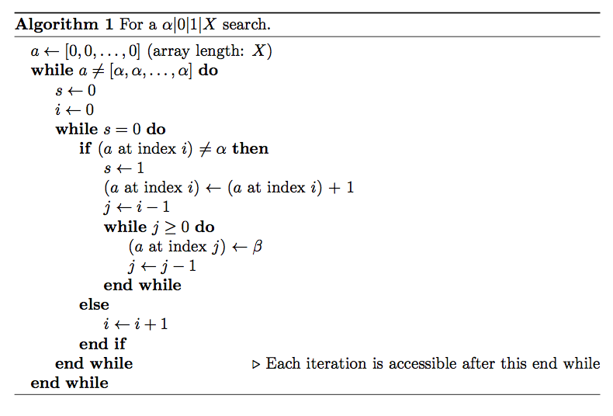
Notes on brute force
It works, it’s an intuitive solution, and it’s very easy to implement in code.
Equivalent to counting in base (max weight + 1)
Not very efficient.

Slide 18
Notes on brute force
It works, it’s an intuitive solution, and it’s very easy to implement in code.
Equivalent to counting in base [max weight + 1]
Not very efficient.
Notes:
On the second bullet: point out the 0 9 situation is base 10, true for any max weight (intuitive), turns out this works with essentially any init weight, and weight step (not just 0 1, intuitive), you can show that the two are really the same thing (equiv not formal) using induction (induction formal compared to intuitive they are same).

Slide 19
Brute force
0 | 0 | … | 0
Let this array represent a combination. Each box represents one available brown material, and contains the weight of that material.
Min weight 0, max weight 9.

Slide 20
Brute force
1 | 0 | … | 0

Slide 21
Brute force
2 | 0 | … | 0

Slide 22
Brute force
9 | 0 | … | 0

Slide 23
Brute force
0 | 1 | … | 0

Slide 24
Brute force
1 | 1 | … | 0

Slide 25
Brute force
9 | 1 | … | 0

Slide 26
Brute force
0 | 2 | … | 0

Slide 27

Notes on brute force
It works, it’s an intuitive solution, and it’s very easy to implement in code.
Equivalent to counting in base [max weight + 1]
Not very efficient.
Notes:
On the second bullet: point out the 0 9 situation is base 10, true for any max weight (intuitive), turns out this works with essentially any init weight, and weight step (not just 0 1, intuitive), you can show that the two are really the same thing (equiv not formal) using induction (induction formal compared to intuitive they are same). Come in handy later.

Slide 28
Notes on brute force
It works, it’s an intuitive solution, and it’s very easy to implement in code.
Equivalent to counting in base [max weight + 1]
Not very efficient.

Slide 29

Notes on brute force
It works, it’s an intuitive solution, and it’s very easy to implement in code.
Equivalent to counting in base [max weight + 1]
Not very efficient.

Slide 30
Notes on brute force
It works, it’s an intuitive solution, and it’s very easy to implement in code.
Equivalent to counting in base [max weight + 1]
Not very efficient.

Slide 31
Brute force is inefficient
As the number of materials and possible weights increase, the number of iterations balloons.
For 3 materials and 10 possible weights, it is 10^3 iterations, which is very small for a modern computer.
But with 4 materials and 100 possible weights, it is 10^8 iterations, which is unreasonably large for most computers.

Slide 32
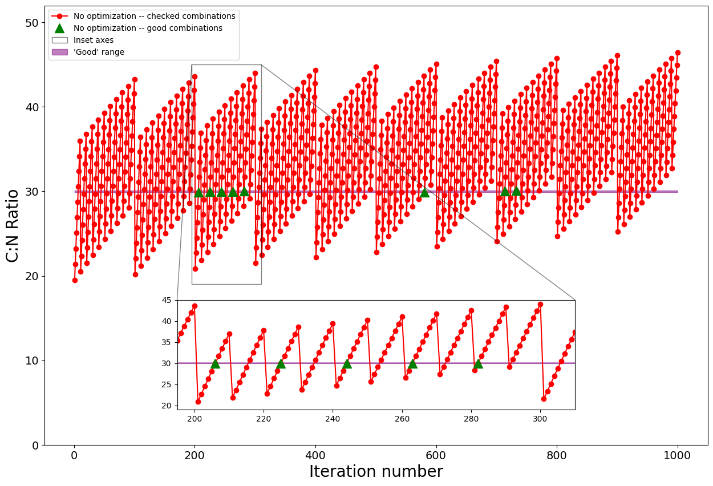
Brute force is inefficient
Weights: 0,1,…,9; 3 materials

Slide 33
Brute force
0 | 0 | … | 0

Slide 34
Brute force
1 | 0 | … | 0

Slide 35
Brute force
2 | 0 | … | 0

Slide 36
Brute force is inefficient
Weights: 0,1,…,9; 3 materials

Slide 37
Brute force
9 | 0 | … | 0

Slide 38
Brute force
0 | 1 | … | 0

Slide 39
Brute force
1 | 1 | … | 0

Slide 40
Brute force is inefficient
Weights: 0,1,…,9; 3 materials

Slide 41
Optimization
Adding a brown material (CN ratio > 30) to some mixture with CN ratio > 30 will always result in a final mixture with CN ratio > 30.
If a certain combination has CN ratio > 30 we can skip subsequent combinations if their only difference is additional brown materials. (these subsequent combinations with also have CN ratio > 30)
Notes:
(Since their CN ratio will be above 30, and we’re only interested in combinations with CN ratio=30)

Slide 42
Optimization
0 | a₂ | a₃ | … | a_{X}
CN ratio = 25

Slide 43
Optimization
1 | a₂ | a₃ | … | a_{X}
CN ratio = 27

Slide 44
Optimization
2 | a₂ | a₃ | … | a_{X}
CN ratio = 29

Slide 45
Optimization
3 | a₂ | a₃ | … | a_{X}
CN ratio = 31
Subsequent iterations of Weight 1 (4-9) with the rest constant will all have CN ratios > 30.

Slide 46
Optimization
0 | a₂ + 1 | a₃ | … | a_{X}
Case 1: CN ratio < 30 (continue)
Case 2: CN ratio > 30
Notes:
For now assume a_2 is not max weight

Slide 47
Optimization
1 | a₂ + 1 | a₃ | … | a_{X}
Case 1: CN ratio < 30 (continue)
Case 2: CN ratio > 30
Notes:
For now assume a_2 is not max weight

Slide 48
Optimization
0 | a₂ + 1 | a₃ | … | a_{X}
Case 1: CN ratio < 30 (continue)
Case 2: CN ratio > 30
Notes:
For now assume a_2 is not max weight

Slide 49
Optimization
0 | 0 | a₃ + 1 | … | a_{X}
Case 1: CN ratio < 30 (continue)
Case 2: CN ratio > 30 (a₂ also skipped)
Notes:
For now assume a_2 is not max weight

Slide 50
Optimization
3 | a₂ | a₃ | … | a_{X}
Case 1: CN ratio < 30 (continue)

Slide 51
Optimization
0 | a₂ + 1 | a₃ | … | a_{X}
Case 1: CN ratio < 30 (continue)
6 iterations skipped 4-9
Notes:
For now assume a_2 is not max weight

Slide 52
Optimization
3 | a₂ | a₃ | … | a_{X}
Case 2: CN ratio > 30 (a₂ also skipped)

Slide 53
Optimization
0 | a₂ + 1 | a₃ | … | a_{X}
Case 2: CN ratio > 30 (a₂ also skipped)
6 iterations skipped 4-9
Notes:
For now assume a_2 is not max weight

Slide 54
Optimization
0 | 0 | a₃ + 1 | … | a_{X}
Case 2: CN ratio > 30 (a₂ also skipped)
6 + 10 * (9 - a₂) iterations skipped
Notes:
For now assume a_2 is not max weight

Slide 55
Optimization
0 | 0 | a₃ + 1 | … | a_{X}
Repeat.
Notes:
For now assume a_2 is not max weight

Slide 56
Optimization
0 | 0 | a₃ + 1 | … | a_{X}
If a combination has CN ratio > 30, and the first n materials are at a minimum, you can skip the iteration of the (n+1)th material
Notes:
Works for n=0.
Start at the iteration with the first n+1 materials at a minimum, and the (n+2)th materials increased by 1

Slide 57
Optimization
0 | a₂ + 1 | a₃ | … | a_{X}
If a combination has CN ratio > 30, and the first n materials are at a minimum, you can skip the iteration of the (n+1)th material
Notes:
For now assume a_2 is not max weight

Slide 58
Optimization
0 | 0 | a₃ + 1 | … | a_{X}
If a combination has CN ratio > 30, and the first n materials are at a minimum, you can skip the iteration of the (n+1)th material
Notes:
For now assume a_2 is not max weight

Slide 59
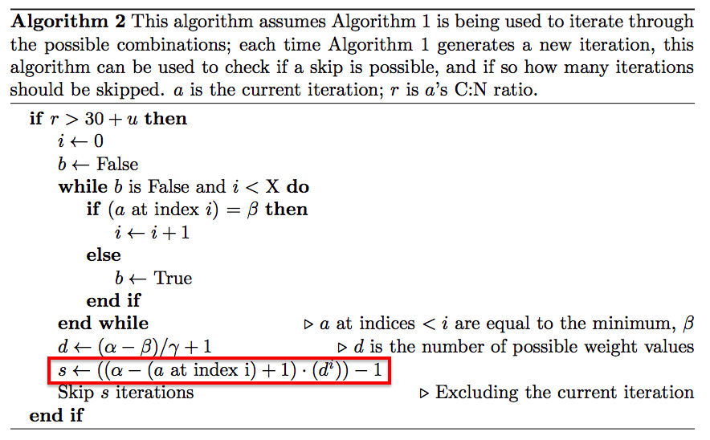
Optimization
Notes:
a at index i is the digit in the (n + 1)th -place.
The box is the number, use from base analogy

Slide 60
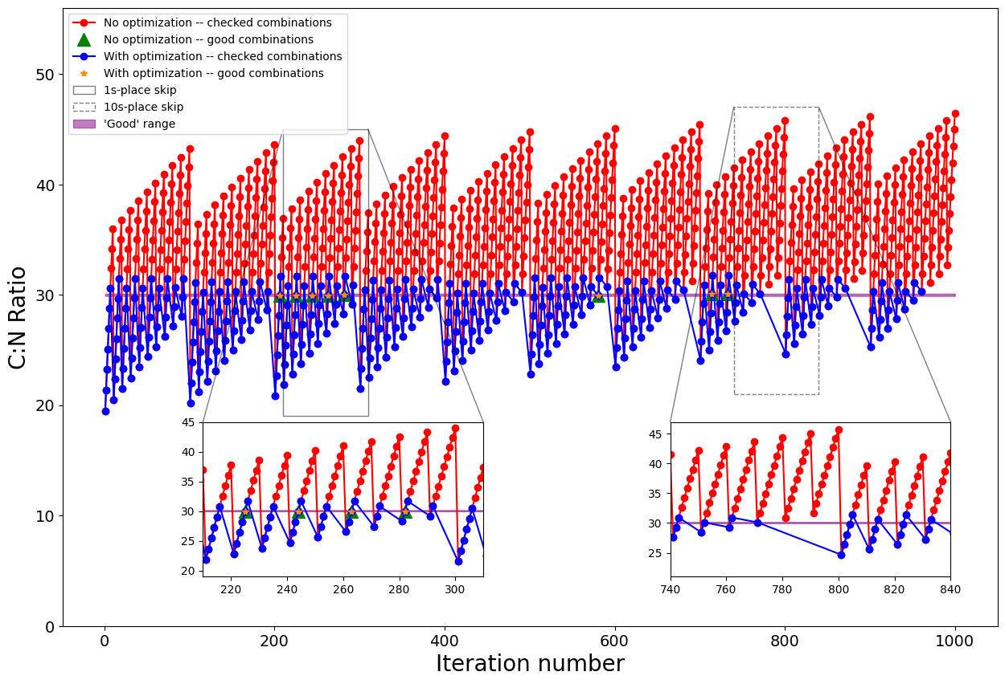
Optimization
Weights: 0,1,…,9; 3 materials
Notes:
Left n=0 skip, n=1 skip

Slide 61
Optimization
3 | a₂ | a₃ | … | a_{X}
Case 1: CN ratio < 30 (continue)

Slide 62
Optimization
0 | a₂ + 1 | a₃ | … | a_{X}
Case 1: CN ratio < 30 (continue)
Notes:
For now assume a_2 is not max weight

Slide 63
Optimization
Weights: 0,1,…,9; 3 materials
Notes:
Left n=0 skip, n=1 skip

Slide 64
Optimization
3 | a₂ | a₃ | … | a_{X}
Case 2: CN ratio > 30 (a₂ also skipped)

Slide 65
Optimization
0 | a₂ + 1 | a₃ | … | a_{X}
Case 2: CN ratio > 30 (a₂ also skipped)
Notes:
For now assume a_2 is not max weight

Slide 66
Optimization
0 | 0 | a₃ + 1 | … | a_{X}
Case 2: CN ratio > 30 (a₂ also skipped)
Notes:
For now assume a_2 is not max weight

Slide 67
Optimization
Weights: 0,1,…,9; 3 materials
Notes:
Left n=0 skip, n=1 skip

Slide 68
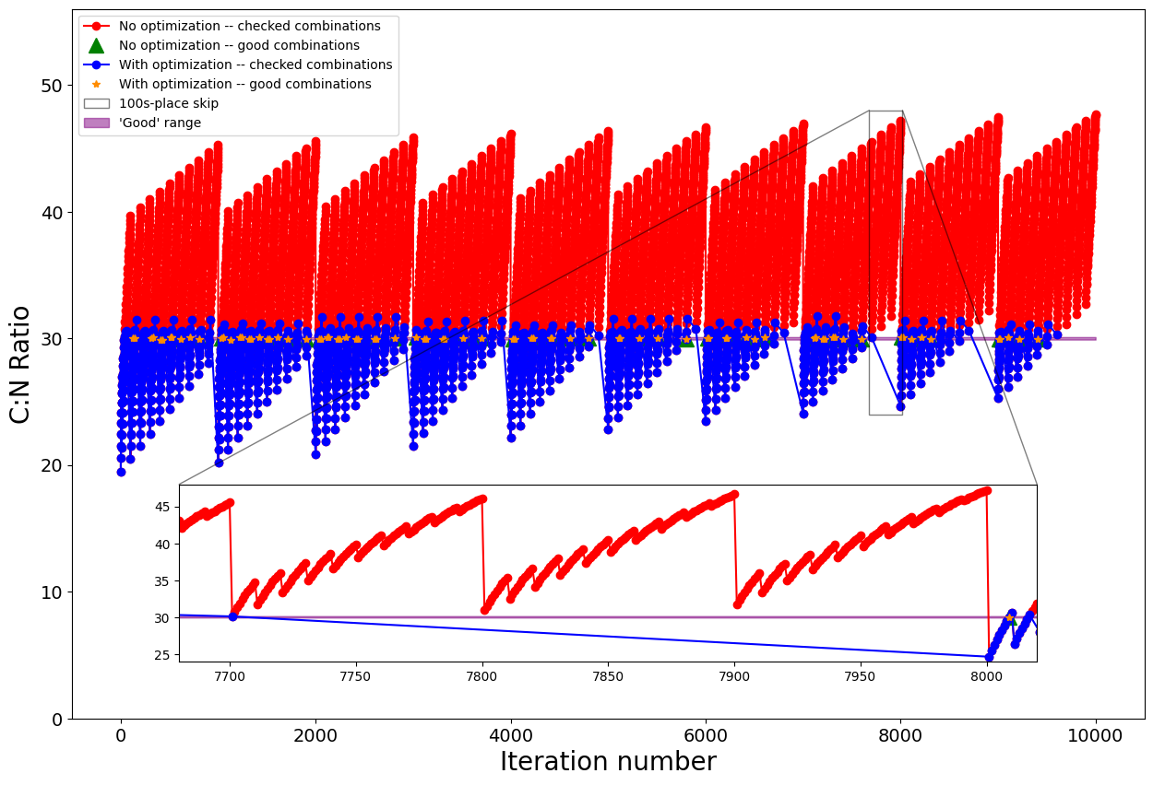
Weights: 0,1,…,9; 4 materials

Slide 69
Optimization
0 | 0 | a₃ + 1 | … | a_{X}
‘Case 3’: CN ratio > 30 after Case 2 skipped
Notes:
For now assume a_2 is not max weight

Slide 70
Weights: 0,1,…,9; 4 materials

Slide 71
Optimization
The number of iterations is decreased from
10,000 to 1,576
10^8 to 18,843
Notes:
Talk about personal experience

Slide 72
Conclusions: practical
Useful for enhancing large composting operations – has already been utilized by Utah schools.
Able to be used on a portable device
Fast

Slide 73

Conclusions

Slide 74
Conclusions: research
Effectiveness of casework optimization and number theory
Systematic optimization may be more effective with more complex problems

Slide 75
Conclusions: limitations and extensions
GUI, more portable design?
Casework optimizations – the bottom
Systemic optimizations

Slide 76
Weights: 0,1,…,9; 4 materials

Slide 77
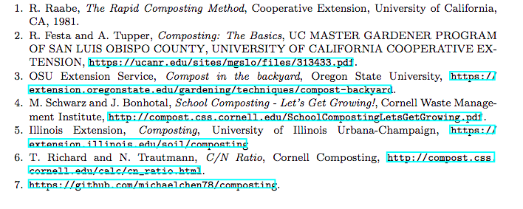
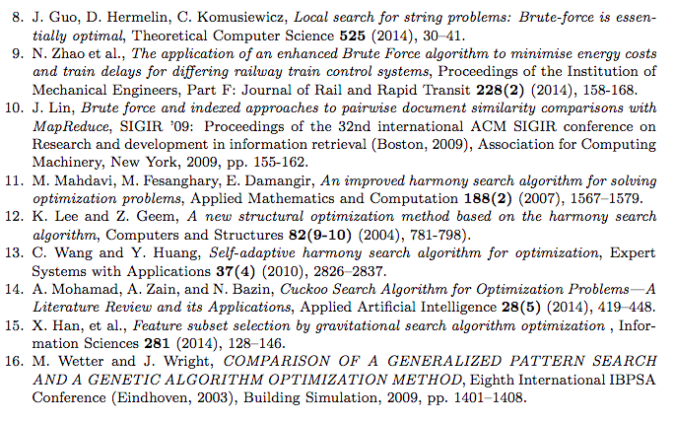
References

Slide 78
End

Slide 79
Potential explanation of the simple solution, or formalizing the problem?

